Slide 1
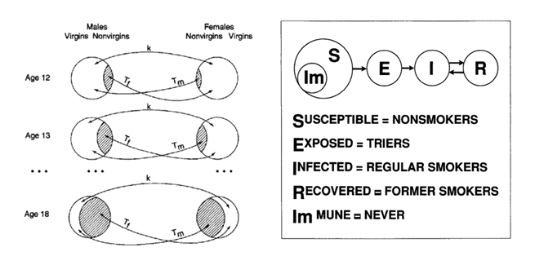
Figure 1: EMOSA models of sexuality onset (1a) and cigarette smoking categories (1b)

Slide 2



























Specifying EMOSA models
Diffusion
Contagion
G
G
$$T_{gi}$$
$$T_{ga}$$
$$k_{gi}$$
$$k_{ga}$$
$$k_{ig}$$
I
$$k_{ia}$$
$$T_{ig}$$
I
$$T_{ia}$$
$$k_{ag}$$
$$k_{ai}$$
A
$$T_{ag}$$
$$T_{ai}$$
A
Starts as
meets
becomes
Starts as
meets
becomes
$$Pt$$
$$Pt$$
$$P_{t+1}$$
$$Pt$$
$$Pt$$
$$P_{t+1}$$
Goer
$$k_{gi}∙P_{t}(G)$$
Goer
$$T_{gi}∙P_{t}(G)∙P_{t}(I)$$
$$k_{ga}∙P_{t}(G)$$
$$T_{ga}∙P_{t}(G)∙P_{t}(A)$$
$$k_{ig}∙P_{t}(I)$$
$$T_{ig}∙P_{t}(I)∙P_{t}(G)$$
Irregular
$$k_{ia}∙P_{t}(I)$$
Irregular
$$T_{ia}∙P_{t}(I)∙P_{t}(A)$$
$$k_{ag}∙P_{t}(A)$$
$$T_{ag}∙P_{t}(A)∙P_{t}(G)$$
$$k_{ai}∙P_{t}(A)$$
$$T_{ai}∙P_{t}(A)∙P_{t}(I)$$
Absentee
Absentee
Figure 2. EMOSA specification for diffusion and contagion models

Slide 3
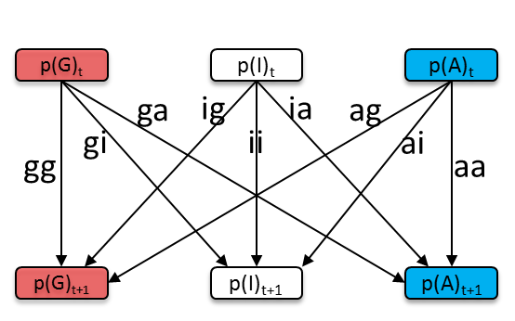
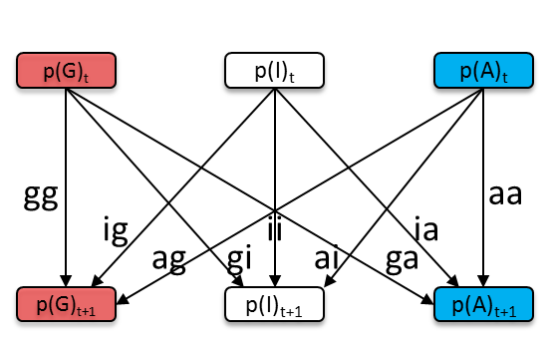
Figure 3. Specification through accounting for transitions
Notes:
Black and white plate

Slide 4
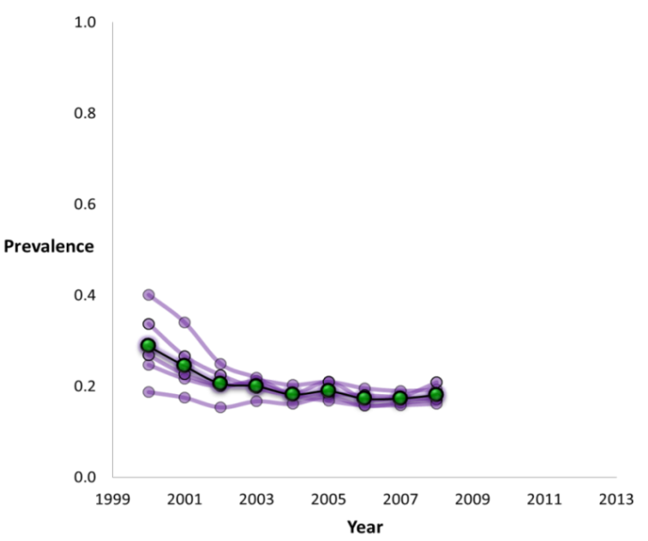
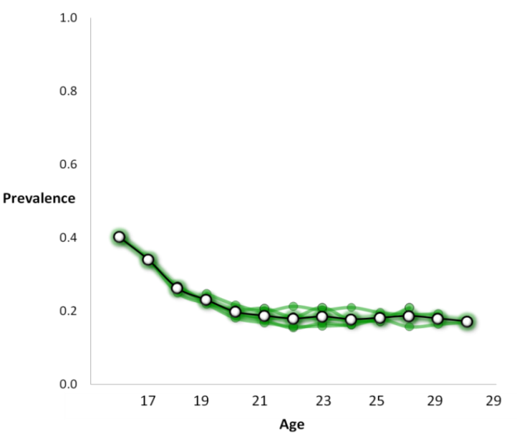
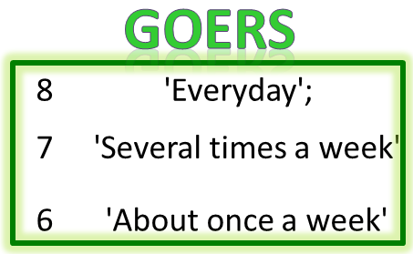
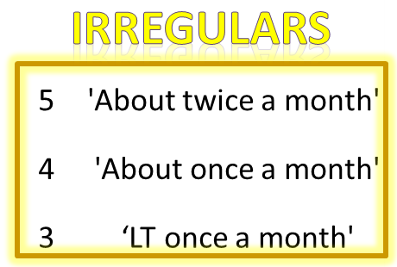
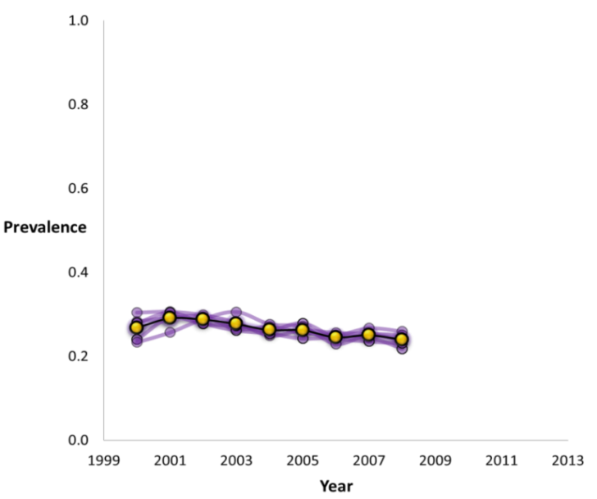
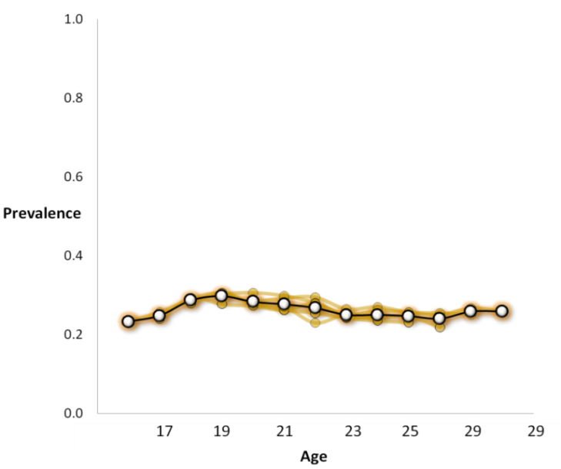
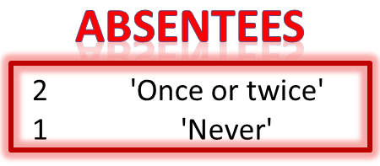
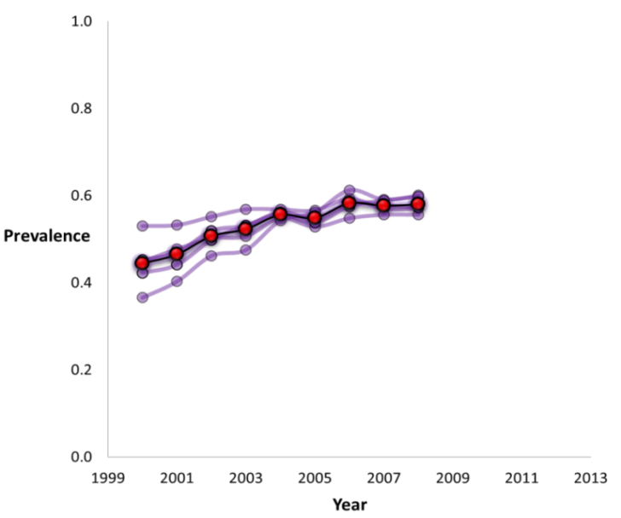
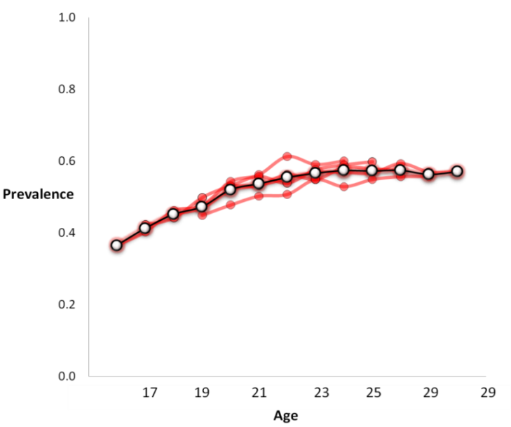
National Longitudinal Survey of Youth 1997
National Representative Sample
N = 5,214
“In the previous year, how many times have you attended
a place of worship?”
Figure 4. Observed prevalence of religious participation categories across time (left) and across age (right)

Slide 5
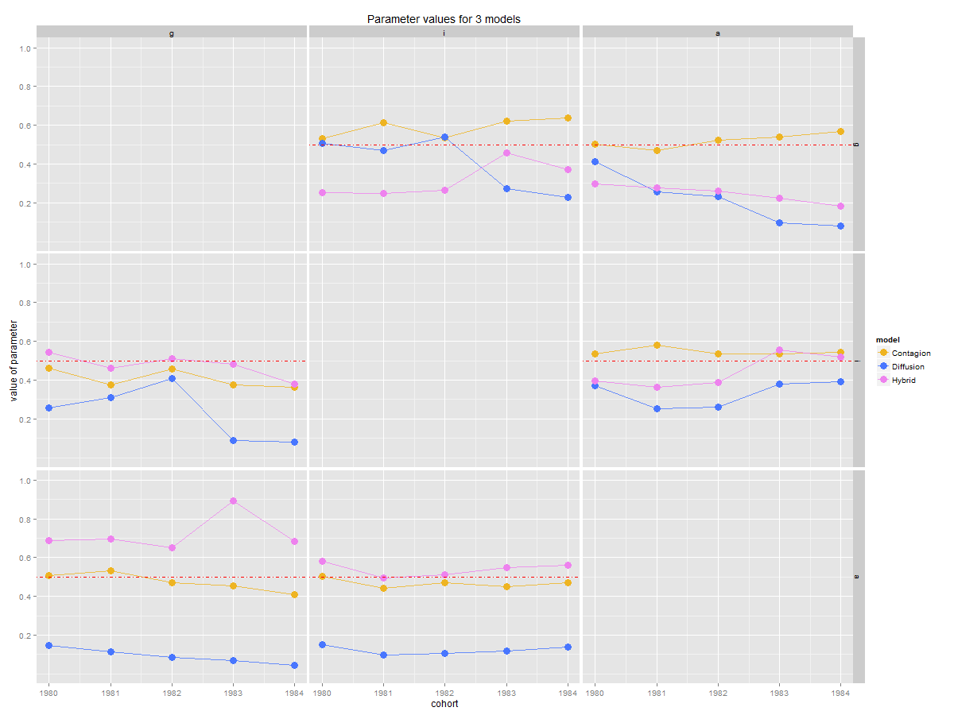
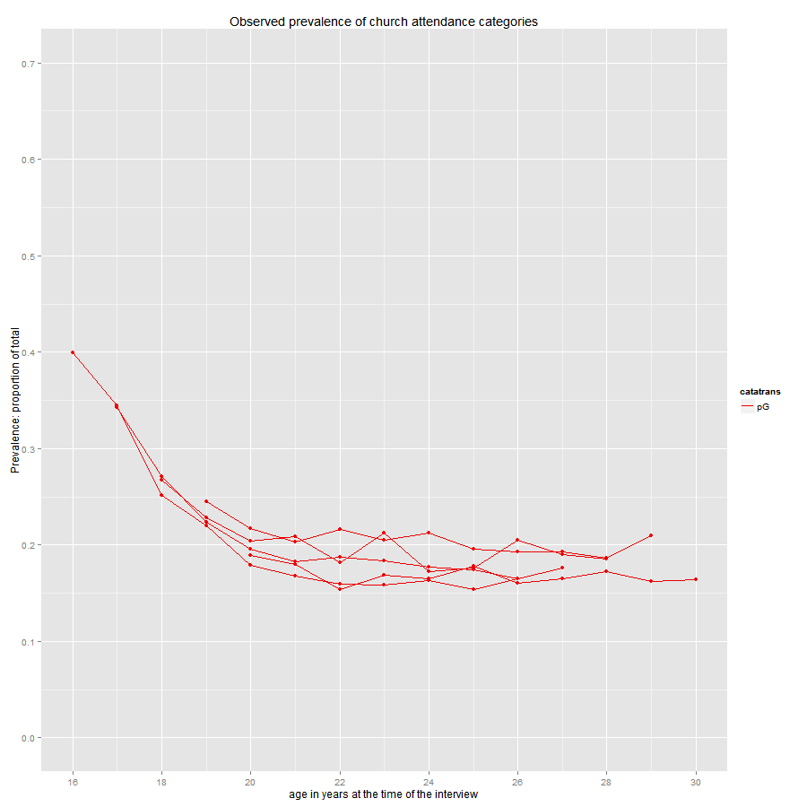
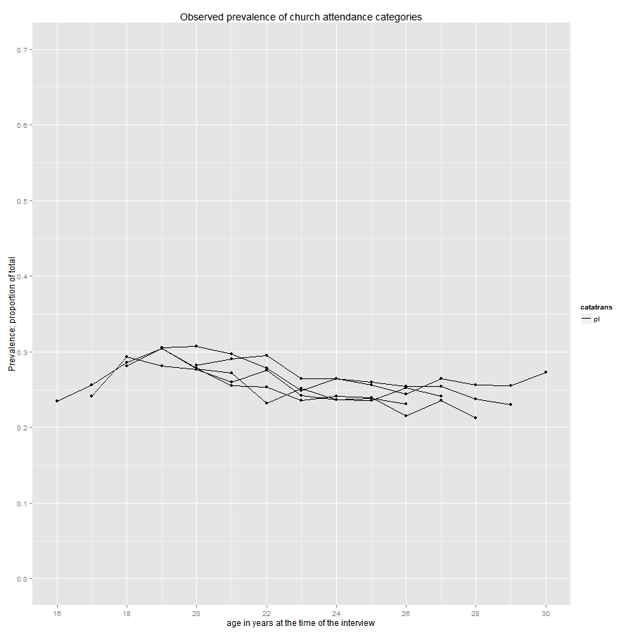
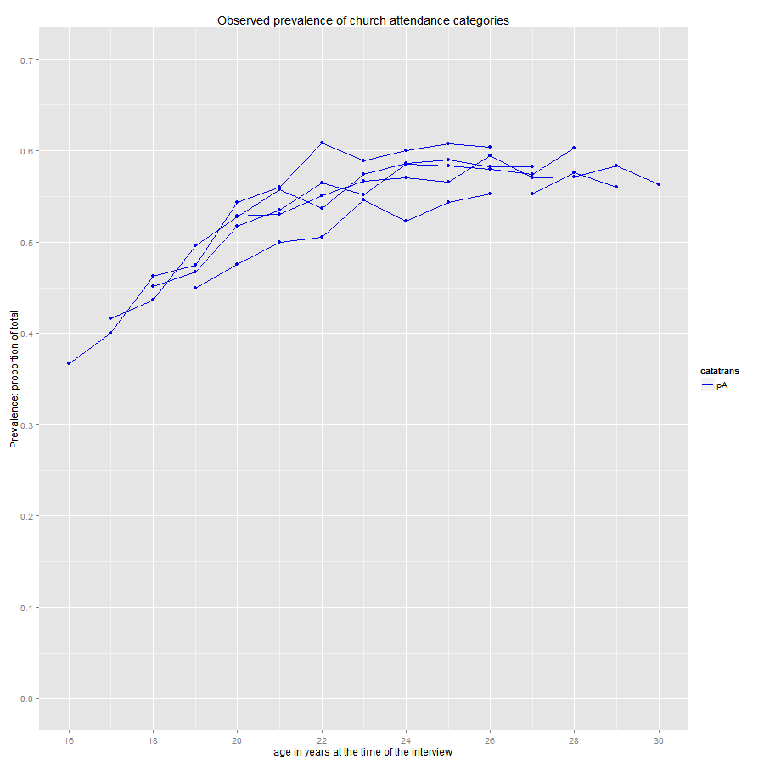
(a)
Diffusion
Contagion
Hybrid
(b)
Goers
Irregulars
Absentees
Figure 5. Estimated parameters as means of posterior distributions

Slide 6
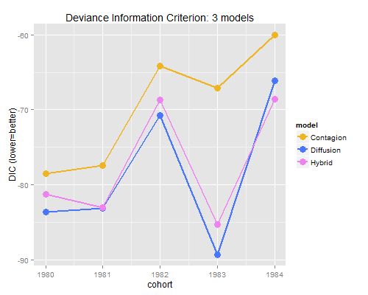
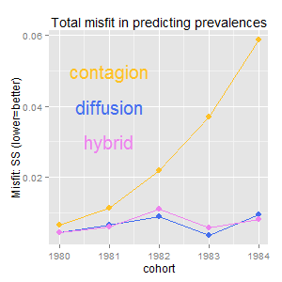
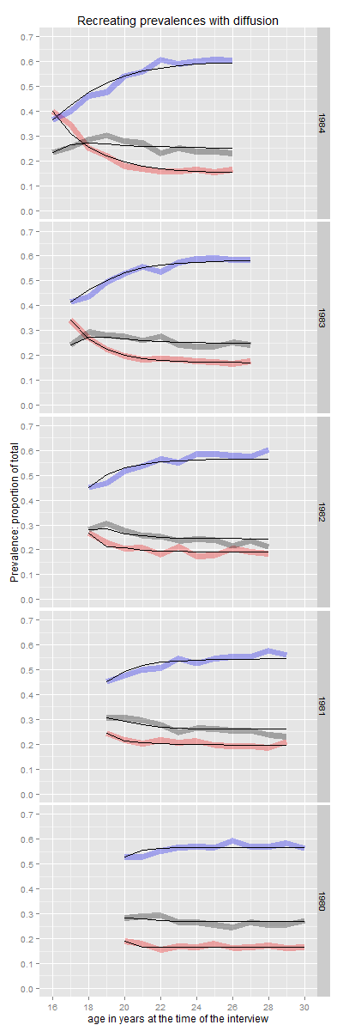
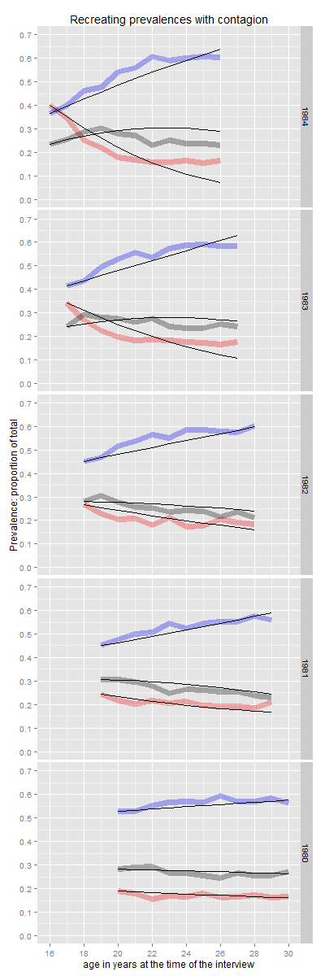
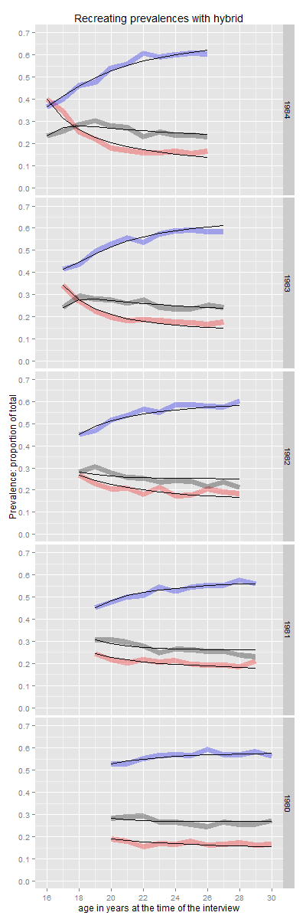
(a)
(b)
(c)
(d)
(e)
Figure 6. Recreating the observed prevalences with fitted models and measuring misfit

Slide 7
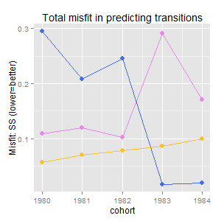
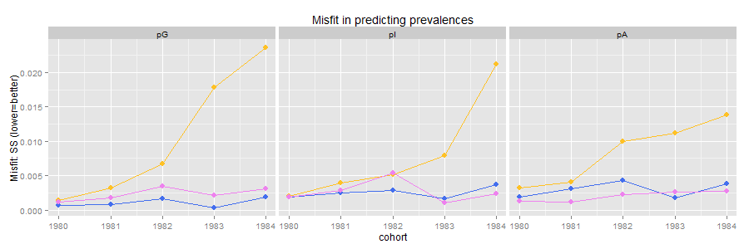
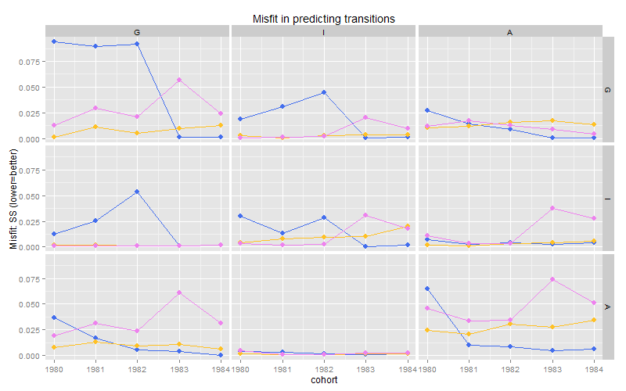
(a)
(b)
(c)
(d)
Figure 7. Model misfit in predicting empirical prevalences and transitions among categories

Slide 8
Old Figure 5
Model Performance
(a)
(b)
Model Solution
(c)
Figure 5. Model performance and estimated parameters

Slide 9
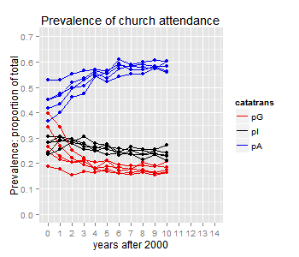
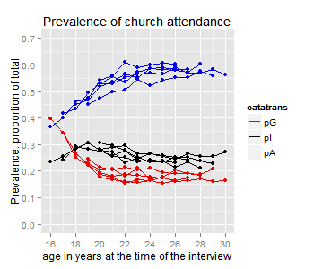
Old Figure 6
Diffusion
Contagion
Hybrid
Figure 6. Recreating the observed prevalences with fitted models

Slide 11
p(G)_{t}
p(I)_{t}
p(A)_{t}
gg
aa
ig
ag
gi
ii
ai
ia
ga
p(G)_{t+1}
p(I)_{t+1}
p(A)_{t+1}
p(G)_{t}
p(I)_{t}
p(A)_{t}
ga
ig
ia
ag
gg
gi
ii
ai
aa
p(G)_{t+1}
p(I)_{t+1}
p(A)_{t+1}

Slide 12
ga
ig
ia
ag
gi
ii
ai
gg
aa
gg
aa
ig
ii
ia
ag
gi
ai
ga

Slide 13
Specifying EMOSA models
Diffusion
Contagion
G
G
$$T_{gi}$$
$$T_{ga}$$
$$k_{gi}$$
$$k_{ga}$$
$$k_{ig}$$
I
$$k_{ia}$$
$$T_{ig}$$
I
$$T_{ia}$$
$$k_{ag}$$
$$k_{ai}$$
A
$$T_{ag}$$
$$T_{ai}$$
A

Slide 14
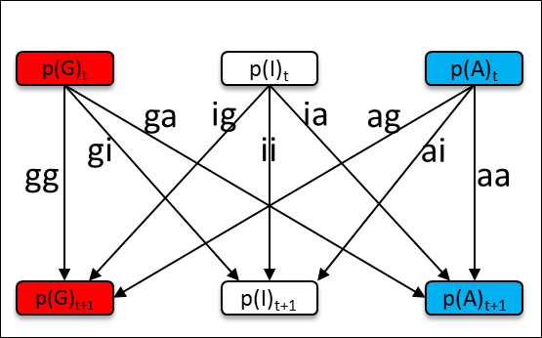
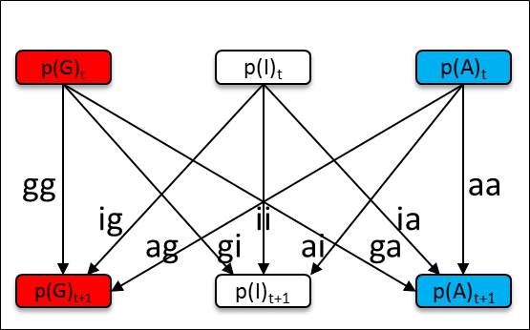
Plate 2. Specification through accounting for transitions

Slide 16

